Slide 1
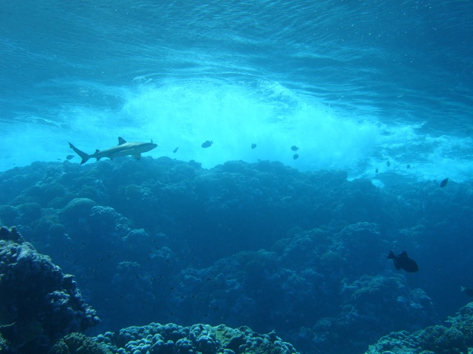

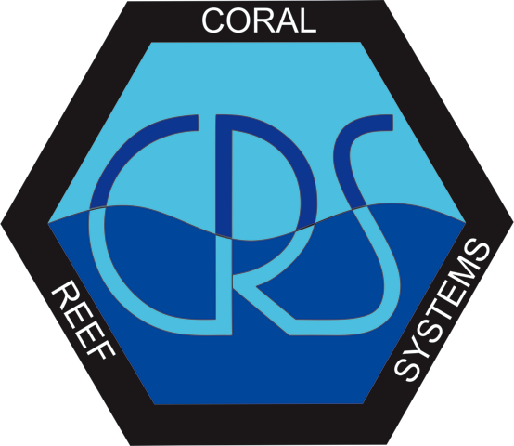
The indirect effects of predators on coral reef fish assemblages
Brian J. Zgliczynski,
Alan Friedlander, Scott Hamilton, Stuart A. Sandin
July 9, 2012
Scripps Institution of Oceanography

Slide 2
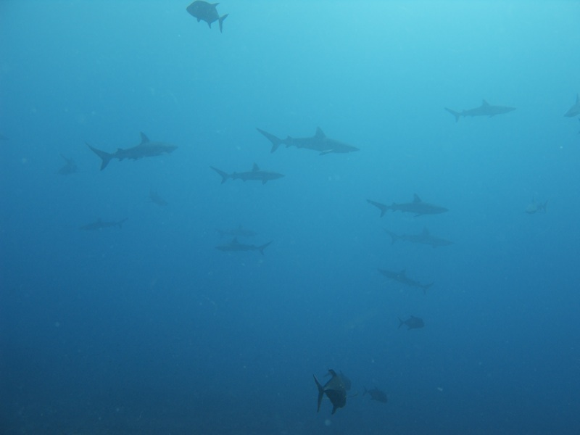
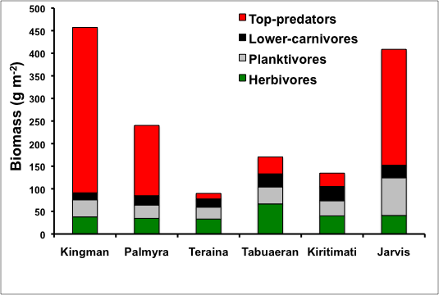
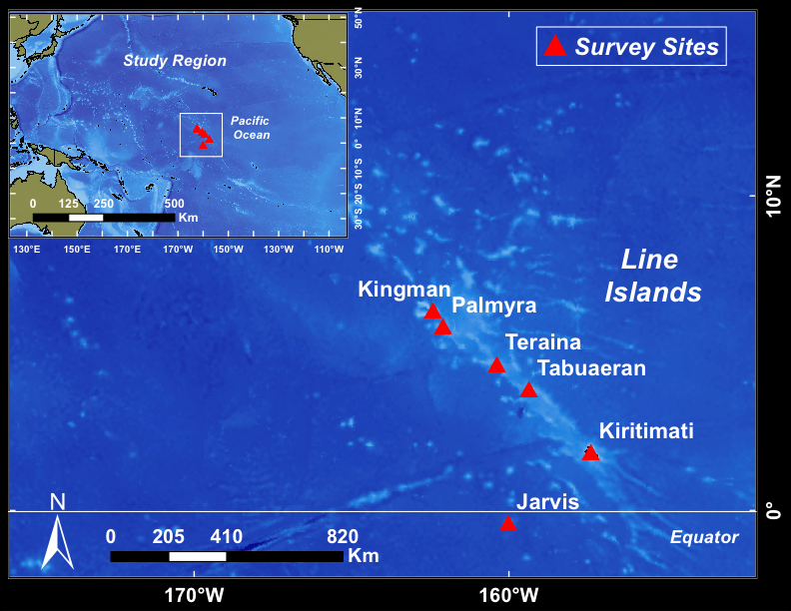
Gradient of predatory fish biomass
Inhabited islands
North ➔ South
Reduction of large predatory species
Alteration of species composition
Reduced standing stock
Shift in the size-structure of fish community

Slide 3
Research Goal
Examine the indirect effects of predators by comparing body condition factors and life-history characteristics of important coral reef fishes across a gradient of predatory biomass.

Slide 4
Research Goal
Examine the indirect effects of predators by comparing body condition factors and life-history characteristics of important coral reef fishes across a gradient of predatory biomass.
Reductions in predatory fish biomass will elicit:
    Positive behavioral responses
    Negative behavioral responses
    Trophically mediated responses, + or –
    Key responses are mass at length and length at age
Notes:
Key responses are mass at length and length at age

Slide 5
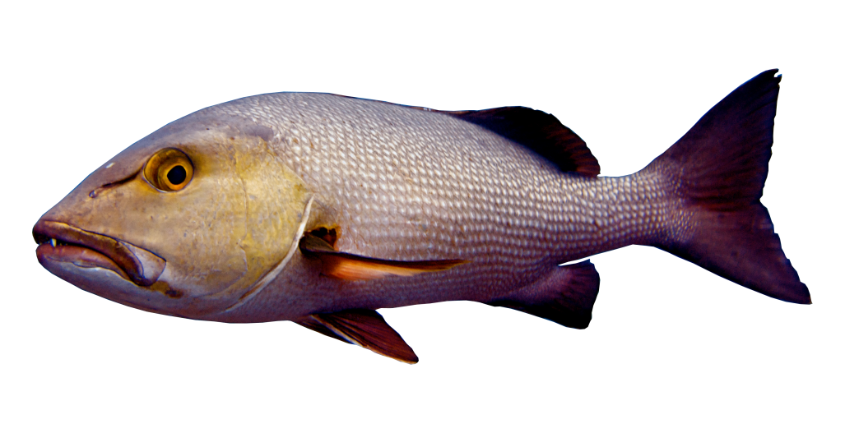
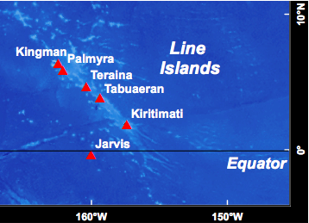
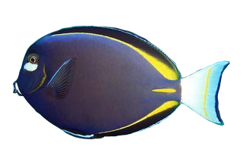
Targeted Collections
Apex predator
Line Islands 2010
Lutjanus bohar
Carnivores
Cephalopholis urodeta
Paracirhites arcatus
Uninhabited
Inhabited
Planktivore
50 individuals across range of body size
Chromis margaritifer
Herbivore
Acanthurus nigricans
Notes:
Examine the Indirect effects by collecting across oceanographic gradient

Slide 6
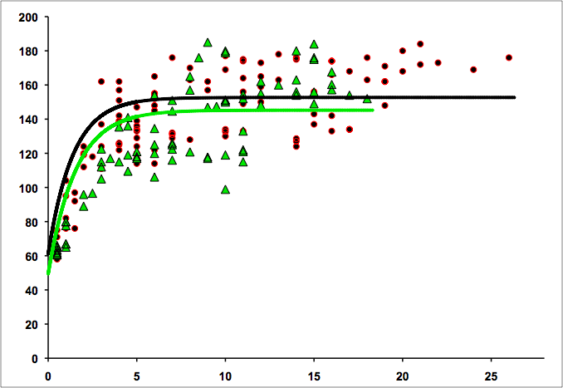
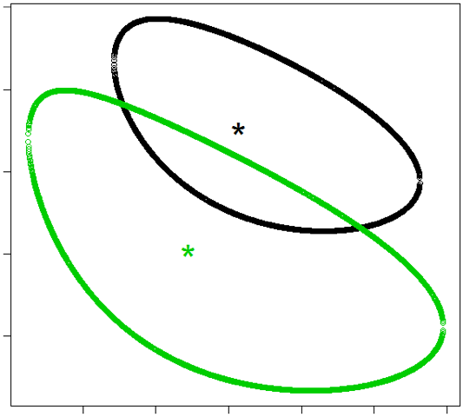
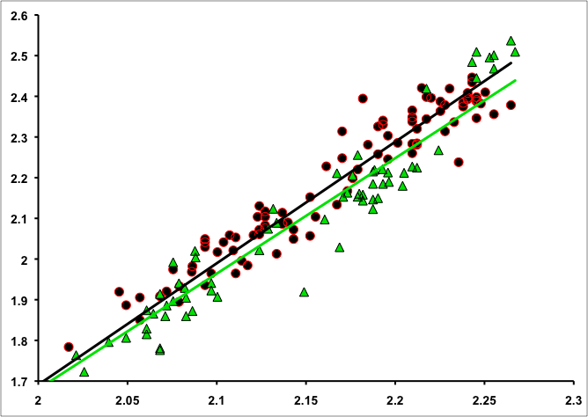
p= 0.04
Herbivore
Acanthurus nigricans
Log₁₀ Weight (g)
Greater mass at length at inhabited islands
Individuals grow faster at inhabited islands
Max age greater at inhabited islands
At inhabited islands food resources are not limited
Trophically mediated response
Uninhabited
Inhabited
Log₁₀ SL (mm)
SL (mm)
L_{inf}
k
Annuli

Slide 7
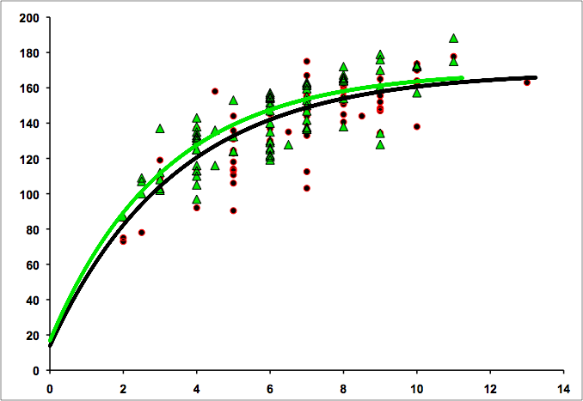
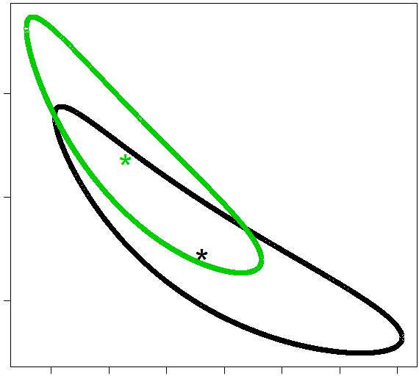
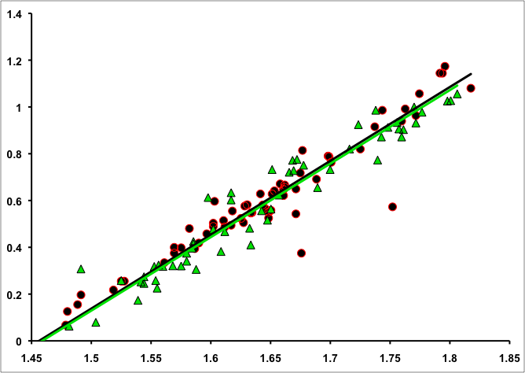
Planktivore
Chromis margaritifer
Log₁₀ Weight (g)
No difference in mass at length and growth between islands
Oceanography likely plays an important role at the island scale
Uninhabited
Inhabited
Log₁₀ SL (mm)
SL (mm)
L_{inf}
k
Annuli

Slide 8
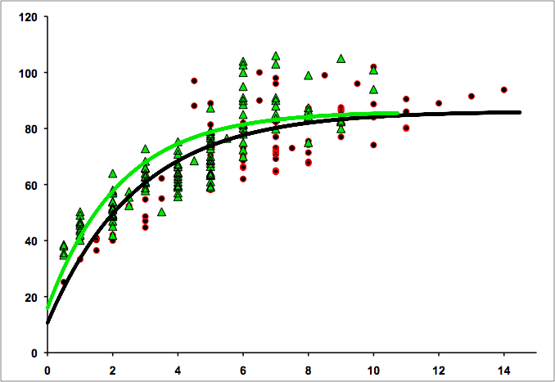
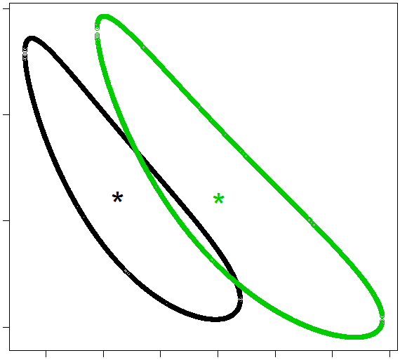
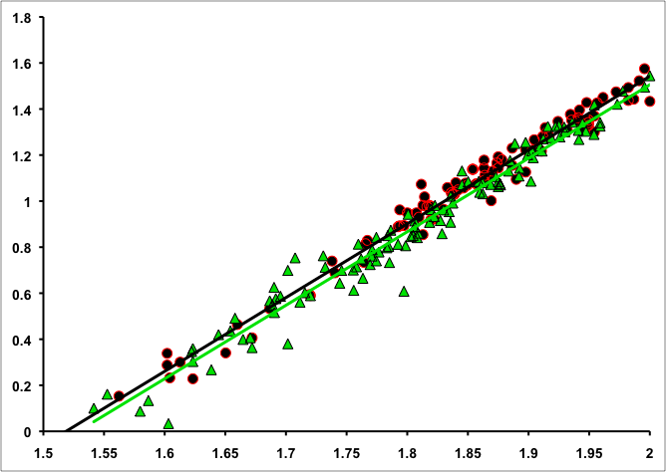
P= 0.04
Carnivore
Paracirhites arcatus
Greater mass at length at inhabited islands
Individuals grow faster at uninhabited islands
Reallocation of energy to length rather than condition in the presence of predators(?)
Positive behavioral response
Log₁₀ Weight (g)
Uninhabited
Inhabited
Log₁₀ SL (mm)
SL (mm)
L_{inf}
k
Annuli

Slide 9
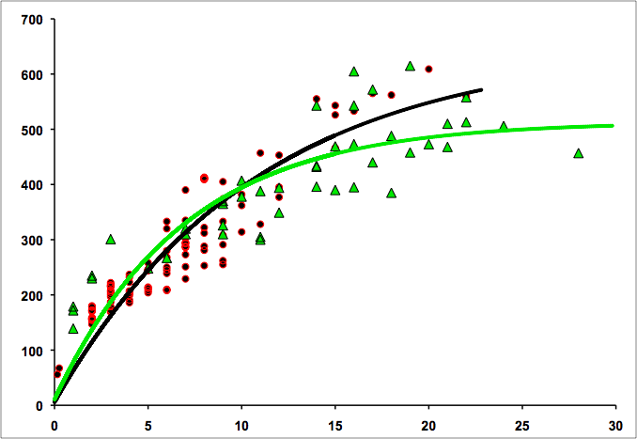
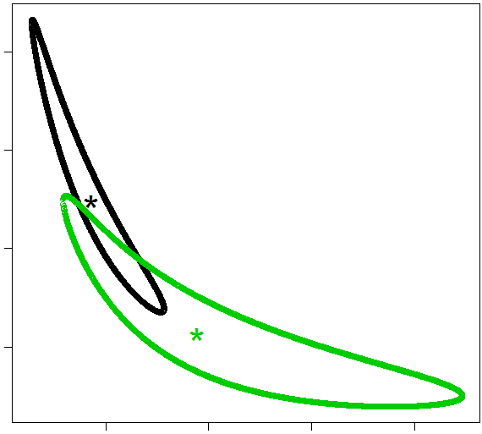
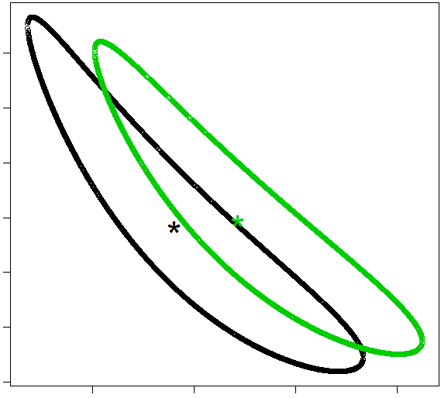
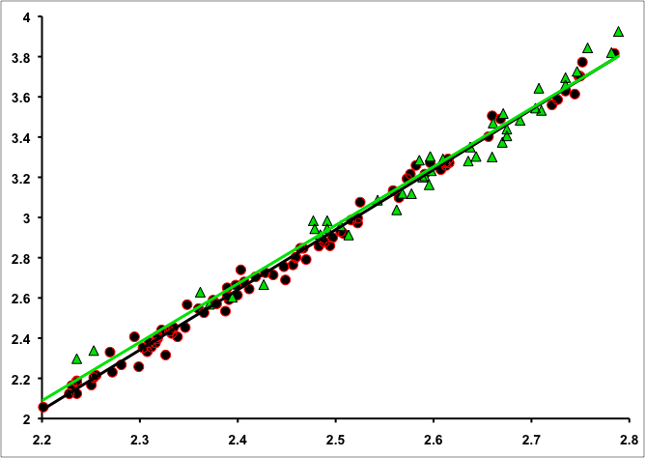
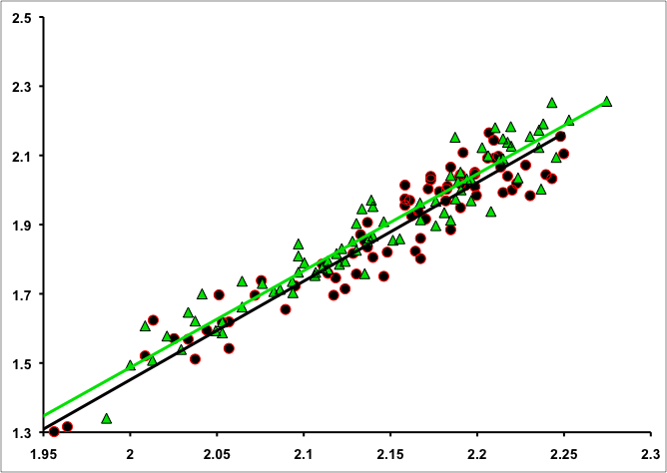
Apex Predator
Carnivore
p= 0.022
p= 0.004
Greater mass at length at uninhabited islands
Individuals grow faster at uninhabited islands
Growth affected by direct exploitation
Positive behavioral response
Lutjanus bohar
Cephalopholis urodeta
Log₁₀ Weight (g)
Uninhabited
Inhabited
Log₁₀ SL (mm)
Log₁₀ SL (mm)
SL (mm)
L_{inf}
L_{inf}
k
k
Annuli
Annuli
Notes:
Growth is affected by direct exploitation and there is evidence that they’re in better condition at un vs. in
but this will get resolved with further analysis at the island level.

Slide 10
Summary
Predators indirectly affect the life history of fish species from lower trophic levels

Slide 11
Summary
Reductions in predatory fish biomass result in species-specific:
    Positive behavioral responses
    Negative behavioral responses
    Trophically mediated responses
Predators indirectly affect the life history of fish species from lower trophic levels

Slide 12
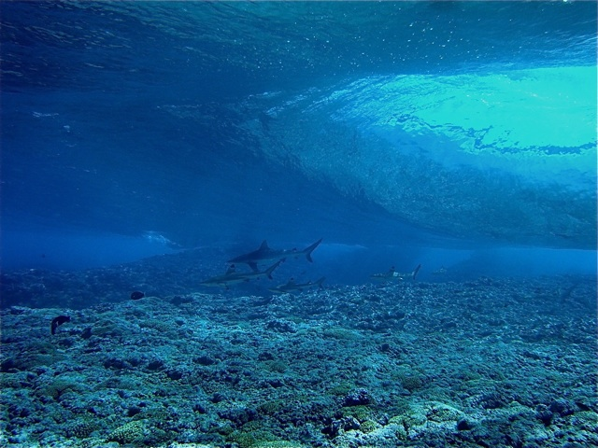



Acknowledgements
Scripps Institution of Oceanography
Center for Marine Biodiversity and Conservation
Integrative Graduate Education and Research Traineeship Program (IGERT)
Ed DeMartini, NOAA Pacific Islands Fisheries Science Center
Sandin Lab, Scripps Institution of Oceanography

